Slide 1
Digital Portfolio
STUDENT NAME: ABIRAMI.S
REGISTER NO AND NMID: 2428C0461 AND BD6C098007C58ACAAC54EA14C9AE7AE5
DEPARTMENT: B.SC.AIML
COLLEGE: KPR COLLEGE OF ARTS SCIENCE AND RESEARCH

Slide 2
DIGITAL PORTFOLIO A Student Academic Portfolio is a digital platform that showcases a student’s educational background, technical skills, projects, achievements, and contact details in a well-structured format. It acts as a professional identity, helping students highlight their strengths and talents beyond traditional resumes. By organizing academic records and accomplishments in a single space, the portfolio not only reflects continuous learning and growth but also provides easy access for teachers, mentors, and recruiters. Ultimately, it serves as a powerful tool for career opportunities, self-improvement, and personal branding

Slide 3


AGENDA
Problem Statement
Project Overview
End Users
Tools and Technologies
Portfolio design and Layout
Features and Functionality
Results and Screenshots
Conclusion
Github Link
3/21/2024 Annual Review

Slide 4

PROBLEM STATEMENT
In many educational institutions, students' academic achievements, skills, projects, and extracurricular activities are scattered across different platforms, documents, and formats. This lack of a centralized, structured, and easily accessible system makes it difficult for students to present their academic journey effectively, and for teachers or employers to assess their progress and potential.
There is a need for a comprehensive, user-friendly digital portfolio system that allows students to document, manage, and showcase their academic performance, projects, certifications, skills, and other accomplishments in one unified platform. Such a system should also enable teachers and administrators to provide feedback, track growth over time, and generate reports when needed.

Slide 5

PROJECT OVERVIEW
The Student Academic Portfolio System is a digital platform designed to help students compile, manage, and present their academic and co-curricular achievements in a structured and visually appealing format. This system acts as a centralized repository where students can upload documents, reflect on their learning journey, and track progress over time.
It also allows educators and academic administrators to view student submissions, provide feedback, and generate analytical insights into student growth. The system supports various types of content including academic records, project reports, certificates, skill development milestones, and extracurricular activities

Slide 6

WHO ARE THE END USERS?
Students who wants to showcase coding projects
Admissions officer looking for evidence of growth and initiative
Mentor/teacher providing feedback and guidance
Employers or admission officers

Slide 7

TOOLS AND TECHNIQUES
HTML – Structure of web pages
CSS – Styling and layout
JavaScript – Interactivity and client-side logic
Code Editor: CodePen (for writing and testing front-end code online)
Browser Developer Tools – Debugging and testing UI
Responsive Design – Ensures compatibility across devices
GitHub – Version control and project collaboration

Slide 8
POTFOLIO DESIGN AND LAYOUT
Education Section
Displays academic background such as school/college details, courses, marks/grades, and year of completion.
Highlights major subjects, specialization, and academic progress.
Skills Section
Lists both technical skills (e.g., programming languages, frameworks, tools) and soft skills (e.g., leadership, teamwork, communication).
Helps recruiters quickly identify the student’s strengths.
Projects Section
Showcases academic projects, mini-projects, and personal works.
Achievements Section
Covers certifications, awards, hackathon participation, and extracurricular accomplishments.
Proves continuous learning and active participation beyond academics.
Contact Section
Provides professional contact details like email ID, phone number, GitHub link.
Ensures easy communication with recruiters, mentors, and institutions.
8

Slide 9
FEATURES AND FUNCTIONALITY
Navigation Bar
A clean and simple menu bar at the top of the page.
Provides quick access to different sections like Education, Skills, Projects, Achievements, and Contact.
Ensures smooth scrolling and easy navigation without confusion.
Interactive Elements
Hover effects, buttons, and clickable project cards to improve user experience.
Clickable GitHub link to directly open external profiles.
Responsive Design for All Devices
Portfolio automatically adjusts to different screen sizes (desktop, laptop, tablet, mobile).
Built using CSS Flexbox, Grid, and Media Queries for responsiveness.
Ensures recruiters and teachers can view the portfolio anytime, on any device, without layout issues

Slide 10
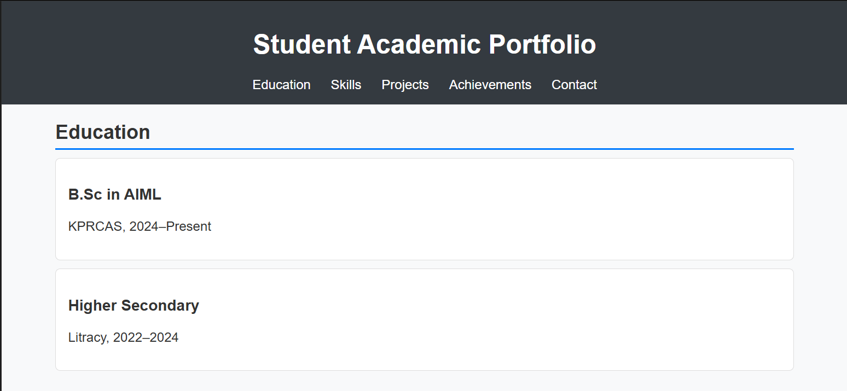
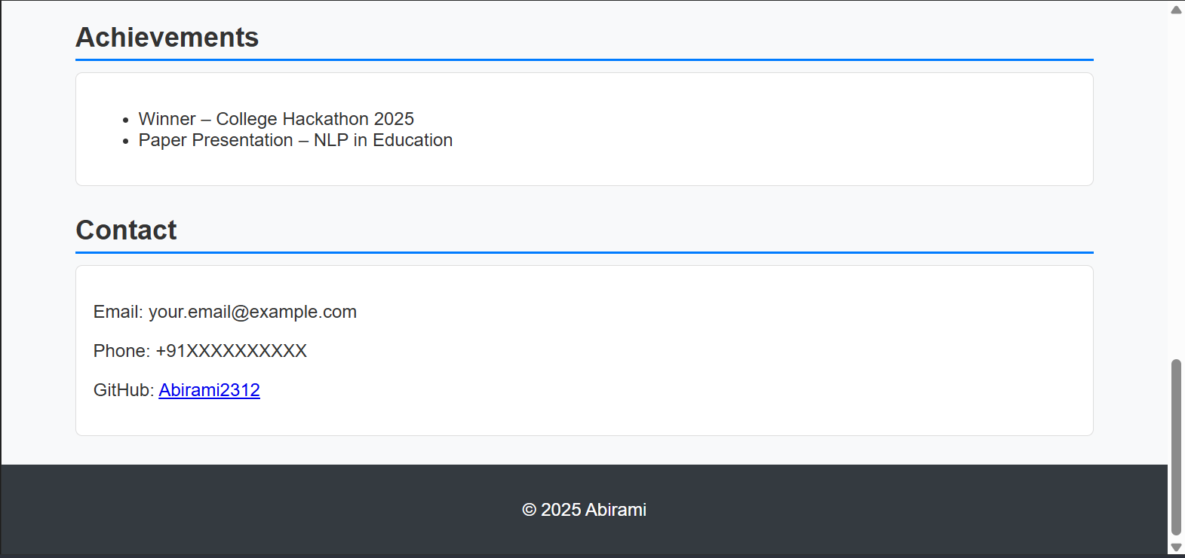

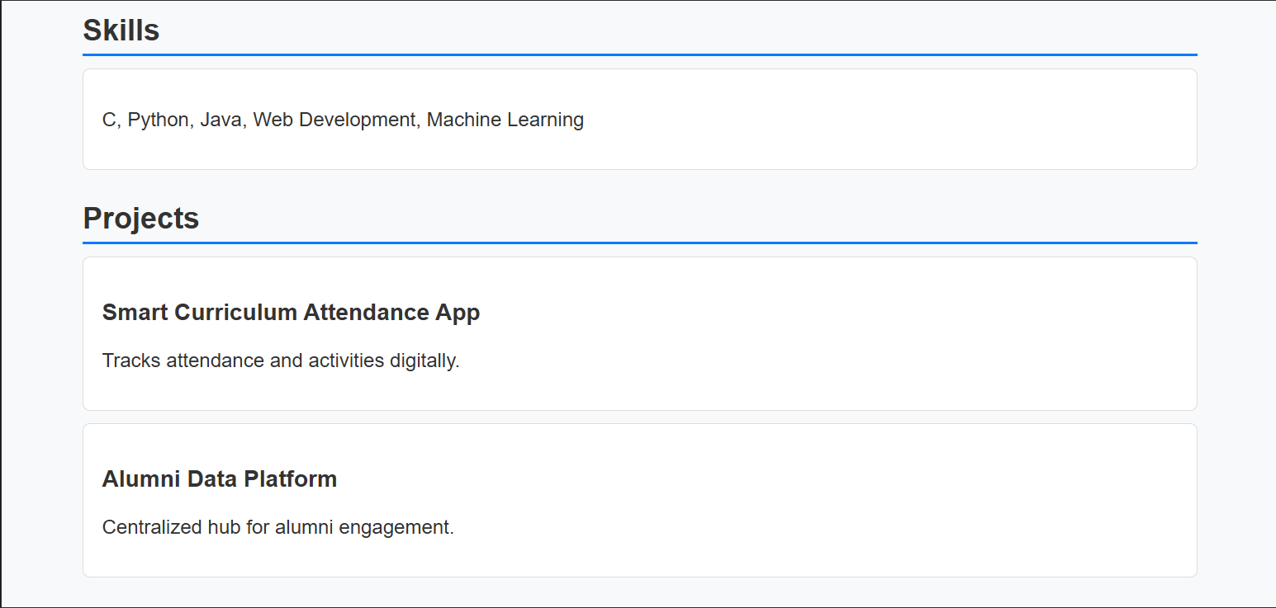
RESULTS AND SCREENSHOTS
3/21/2024 Annual Review
10

Slide 11
CONCLUSION
The Student Academic Portfolio serves as a modern and effective platform for representing a student’s academic journey, skills, projects, and achievements in a structured and professional way. Unlike traditional resumes, it provides an interactive and visually appealing medium to showcase continuous growth and learning. By building and maintaining this portfolio, students can create a strong digital identity that supports their career goals, while also improving their technical and presentation skills. Overall, the portfolio not only acts as a personal branding tool but also bridges the gap between students, mentors, and recruiters, opening the door to future academic and professional opportunities.
GITHUB LINK: https://github.com/Abirami2312/Digital-portfolio
11

